Slide 1




Restaurant Rating Prediction Project
Presented by - Aditya Kumar Singh

Slide 2
Abstract
This project aims to develop a machine learning model to predict the aggregate rating of restaurants based on various features. By analyzing data related to restaurant characteristics and operations, the model seeks to provide accurate predictions that can help restaurant owners and potential customers make informed decisions. The study leverages historical restaurant data and employs multiple machine learning algorithms, including Linear Regression, Decision Tree, Random Forest, and Gradient Boosting.

Slide 3
Introduction
The restaurant industry is highly competitive, and ratings play a crucial role in influencing customer choices. Predicting restaurant ratings can help restaurant owners improve their services and attract more customers. This project focuses on building a predictive model that uses restaurant data to estimate their ratings.

Slide 4
Objective
The main objective is to develop a machine learning model to predict restaurant ratings based on features such as location, cuisine, cost, and operational attributes. The model should provide accurate predictions to help stakeholders understand and improve restaurant performance.

Slide 5
Problem Statement
Given a dataset with various attributes of restaurants, including their geographical location, cuisine types, cost, booking and delivery options, and customer feedback, develop a predictive model to estimate the aggregate rating of each restaurant.

Slide 6
Dataset description
The dataset contains information about restaurants, including unique identifiers, names, location details, cuisine types, cost for two, operational features, and customer ratings. Key columns include Restaurant ID, Restaurant Name, Country Code, City, Cuisines, Average Cost for Two, Has Table Booking, Has Online Delivery, Price Range, Aggregate Rating, and Votes.

Slide 7
Exploratory Data Analysis and Data Visualization

Slide 8
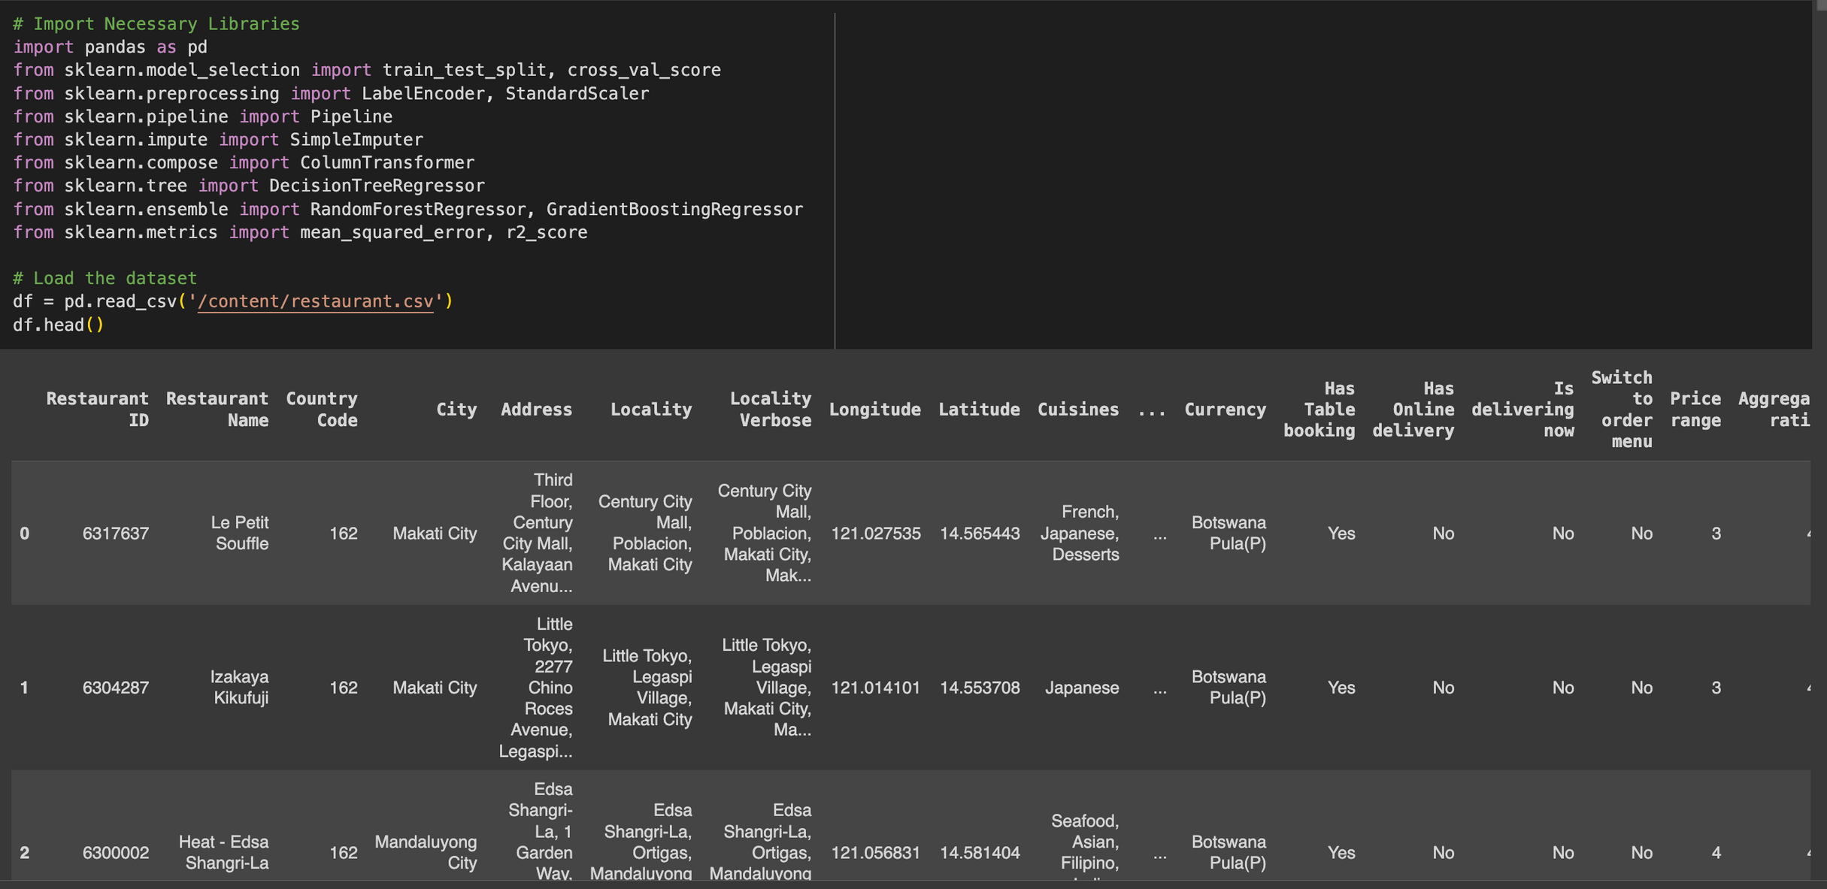

Slide 9
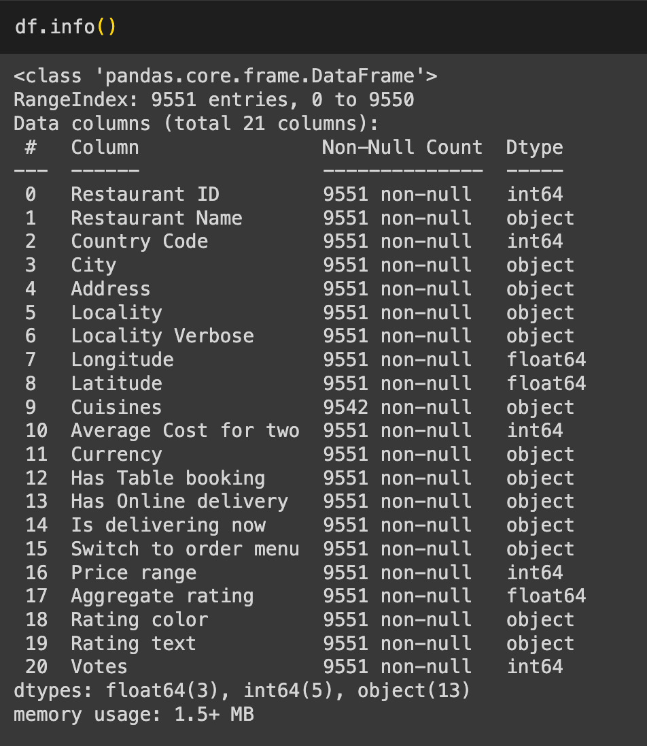

Slide 10
Cuisines Distribution

Slide 11
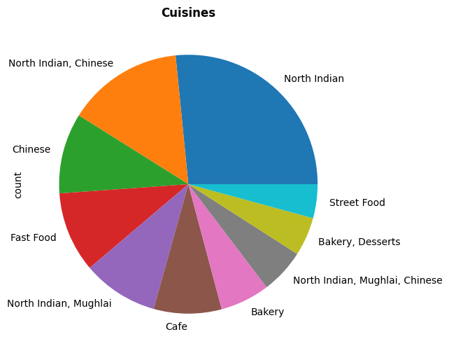

Slide 12
Percentages of all Cuisines types

Slide 13
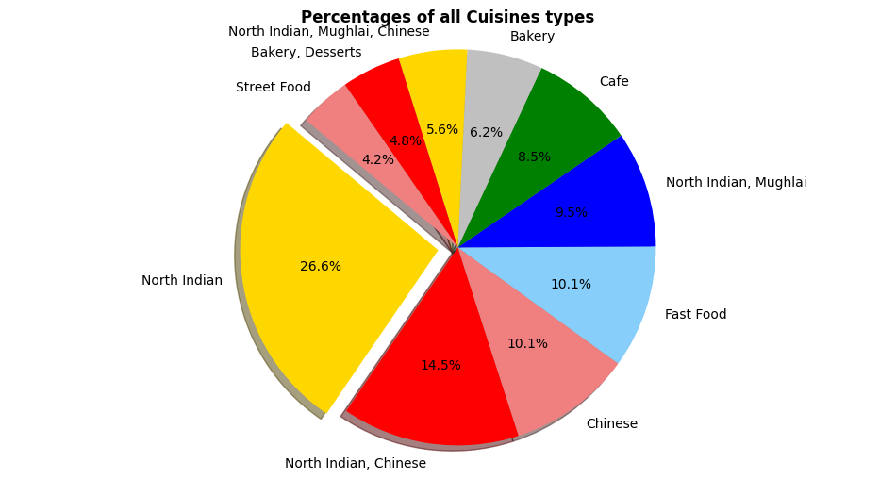

Slide 14
Cuisines overall count

Slide 15
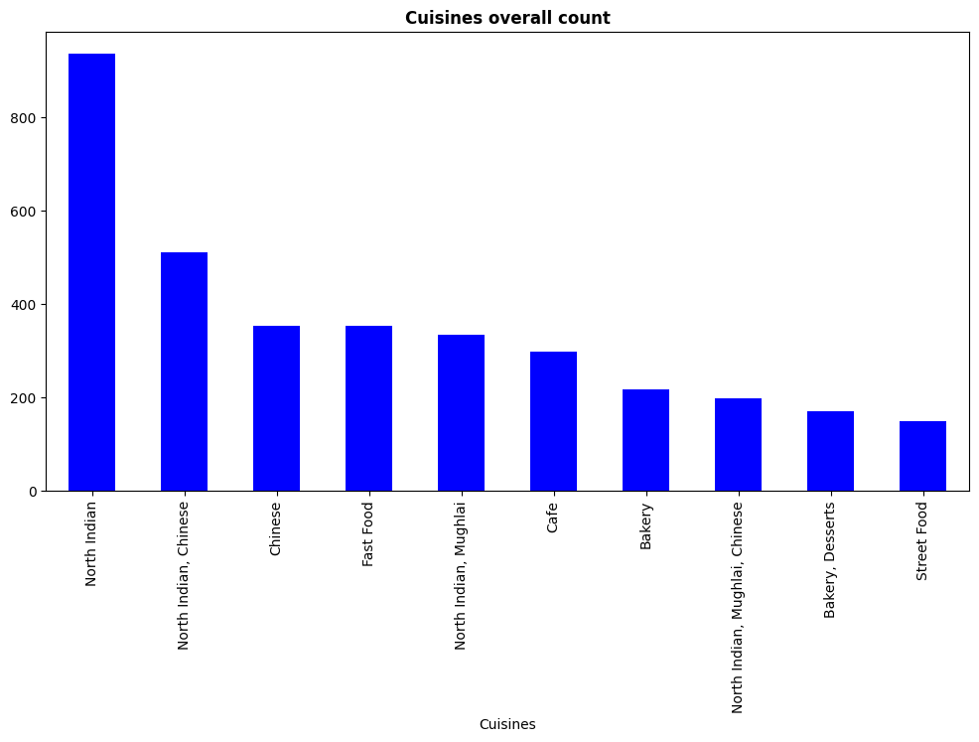

Slide 16
Distribution of Aggregate Rating

Slide 17
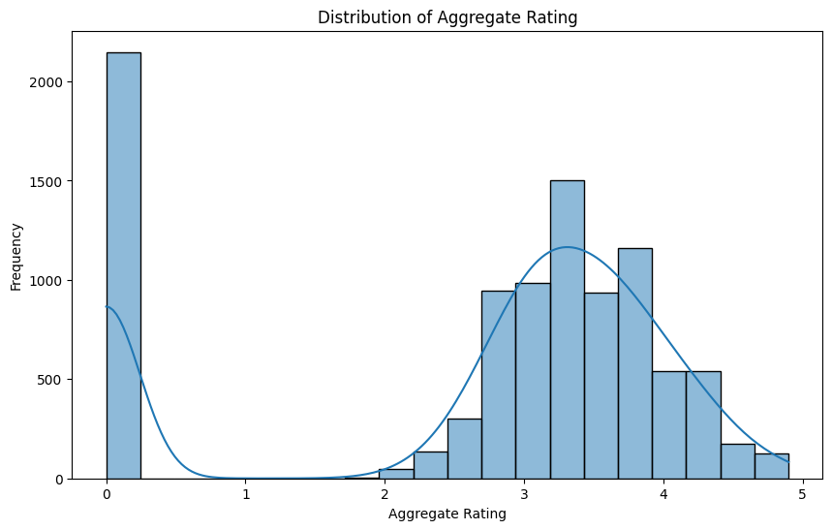

Slide 18
Average cost for 2 people in Rupees

Slide 19
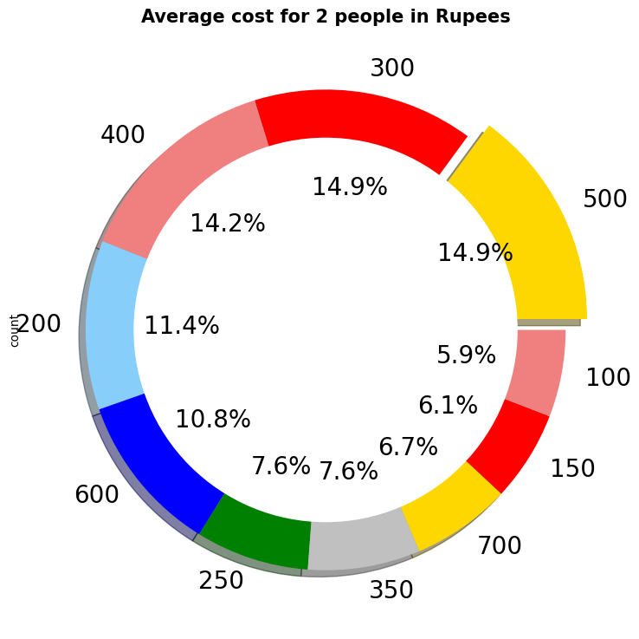

Slide 20
Model Selection: Overview of chosen models: Linear Regression, Decision Tree, Random Forest, and Gradient Boosting.

Slide 21
Linear Regression model

Slide 22
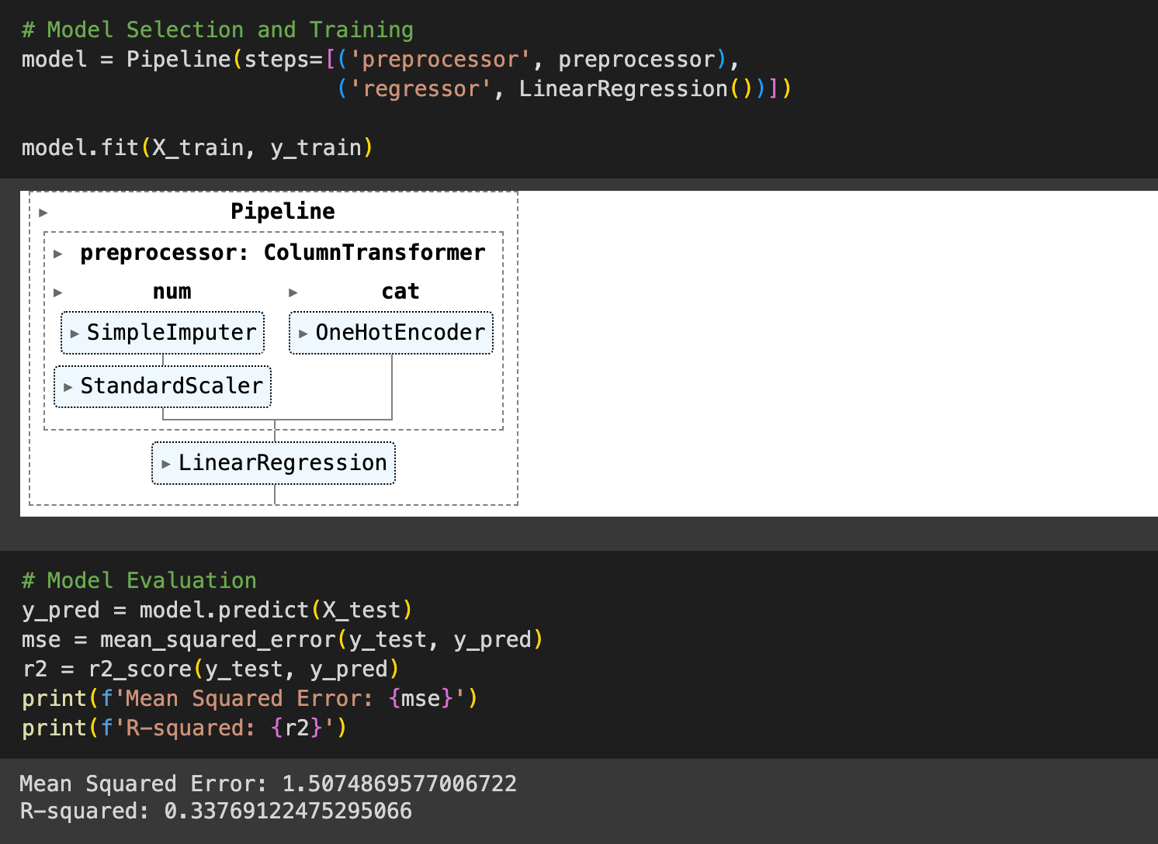

Slide 23
Random Forest and Gradient Boosting

Slide 24
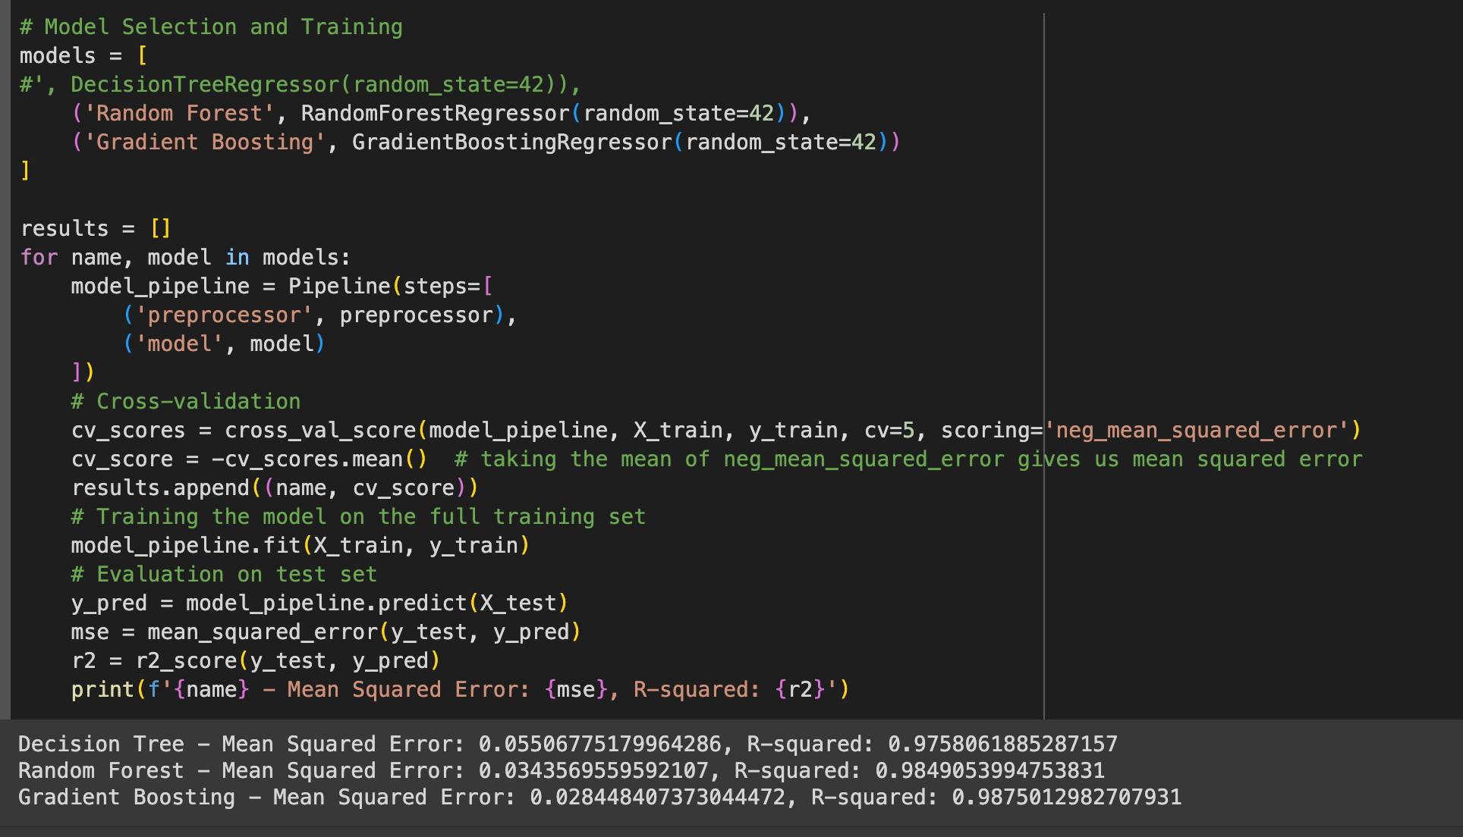

Slide 25
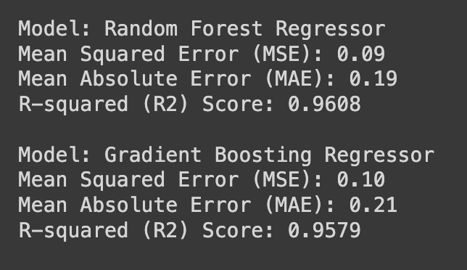

Slide 26
Mean Squared Error (MSE) of Models

Slide 27
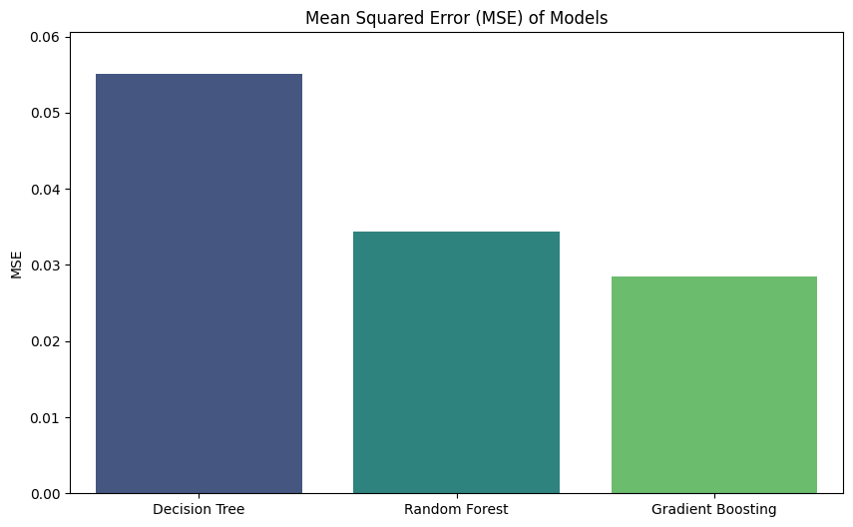

Slide 28
THANK YOU

